Slide 1

Instrumentation and Control
CSE 325
The greatest torture souls feel in hell, In hell, that they must live, and cannot die.
-The White Devil by John Webster
Mehedi Hasan
Lecturer
Computer Science and Engineering(CSE)
Daffodil International University(DIU)

Slide 2
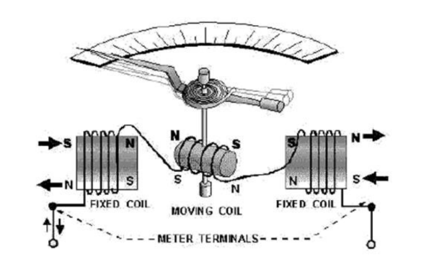
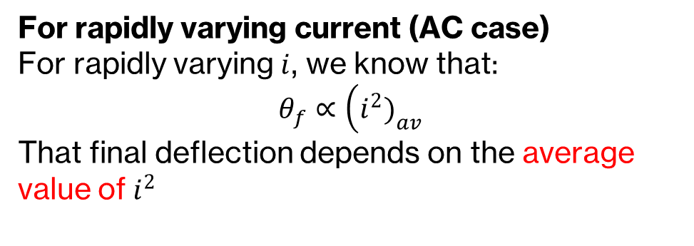
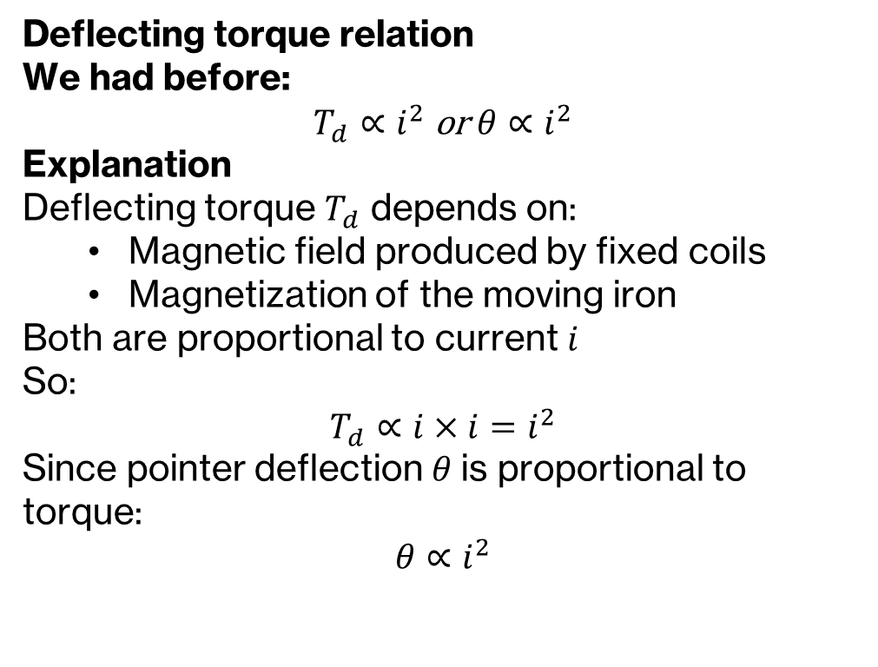
Measurement Of Power and Energy
The fixed coils and the movable coil are connected in series; same current flows through them (Fixed coils and Movable element)
Deflecting torque relation
We had before:
$$T_{d}∝i^{2} \text{or} θ∝i^{2}$$
Explanation
Deflecting torque $T_{d}$ depends on:
Magnetic field produced by fixed coils
Magnetization of the moving iron
Both are proportional to current $i$
So:
$$T_{d}∝i×i=i^{2}$$
Since pointer deflection $θ$is proportional to torque:
$$θ∝i^{2}$$
For rapidly varying current (AC case)
For rapidly varying $i$, we know that:
$$θ_{f}∝\left(i^{2}{\left.)\right.}_{av}\right.$$
That final deflection depends on the average value of $i^{2}$

Slide 3
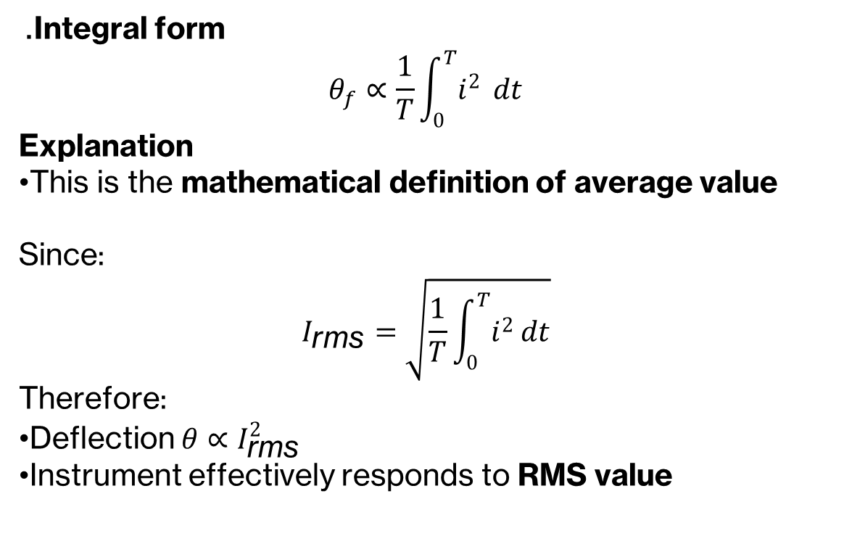
Measurement Of Power and Energy
The fixed coils and the movable coil are connected in series; same current flows through them (Fixed coils and Movable element)
. Integral form
$$θ_{f}∝\frac{1}{T}\int_{0}^{T}{i^{2}} dt$$
Explanation
This is the mathematical definition of average value
Since:
$$I_{\text{rms}}=\sqrt{\frac{1}{T}\int_{0}^{T}{i^{2}}dt}$$
Therefore:
Deflection $θ∝I_{\text{rms}}^{2}$
Instrument effectively responds to RMS value

Slide 4
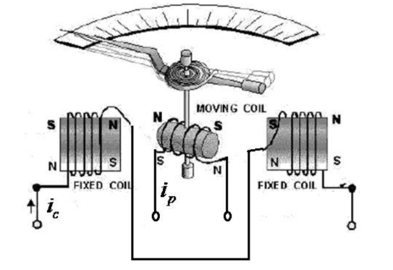

Measurement Of Power and Energy
When used as a WATTMETER, the coils are connected in a different way, as voltage and current, both, are responsible for power.
Fixed Coils: Connected in series, effectively work as a single coil (Current Coil)
Movable Coil: Connected in series with a high-resistance resistor, together work as Potential Coil (also called Pressure Coil)

Slide 5
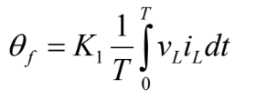


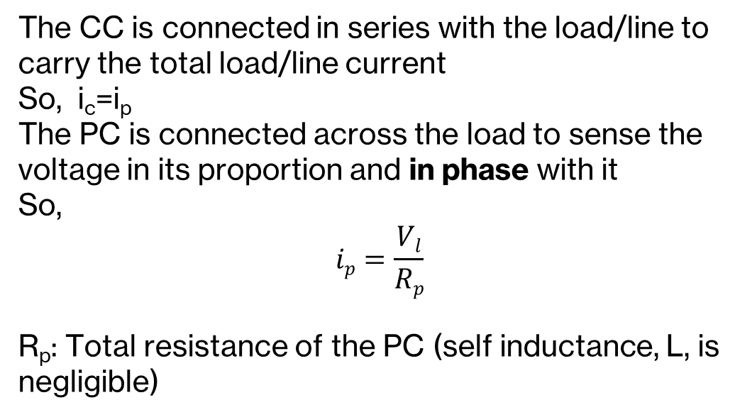
Measurement Of Power and Energy
The CC is connected in series with the load/line to carry the total load/line current So, i_{c}=i_{p} The PC is connected across the load to sense the voltage in its proportion and in phase with it So,
$$ip=\frac{Vl}{Rp}$$
R_{p}: Total resistance of the PC (self inductance, L, is negligible)
The deflection equation now becomes:
By definition, the average power in a circuit/consumed by a load is
That means,
So, the electrodynamometer deflection linearly varies with the average power of the load/circuit.

Slide 6
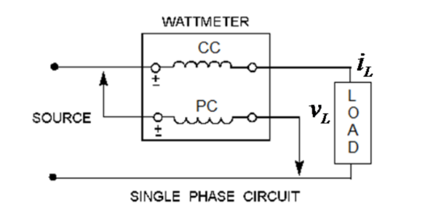
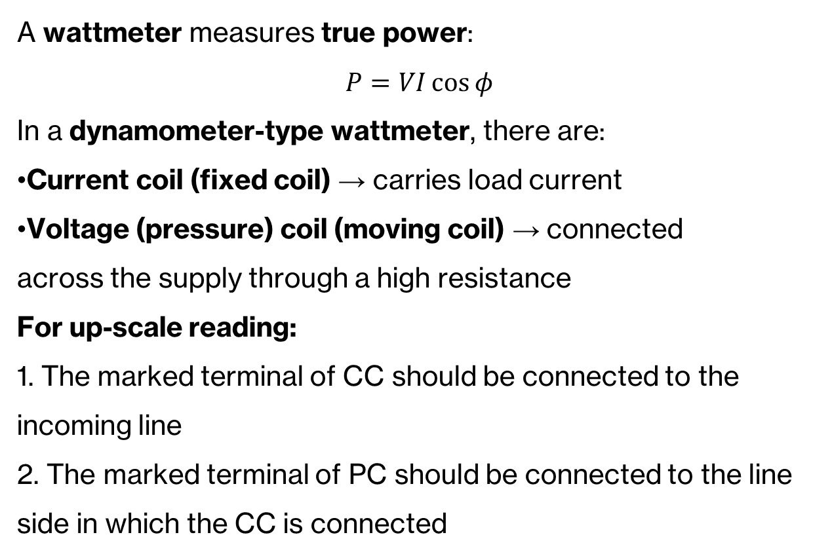
Wattmeter Connections
A wattmeter measures true power:
$$P=VI\cos{φ}$$
In a dynamometer-type wattmeter, there are:
Current coil (fixed coil) → carries load current
Voltage (pressure) coil (moving coil) → connected
across the supply through a high resistance
For up-scale reading:
1. The marked terminal of CC should be connected to the incoming line
2. The marked terminal of PC should be connected to the line side in which the CC is connected
For correct reading of the load power:
1.The CC should carry exactly the load current; and
2. The PC should be connected across the load terminals

Slide 7
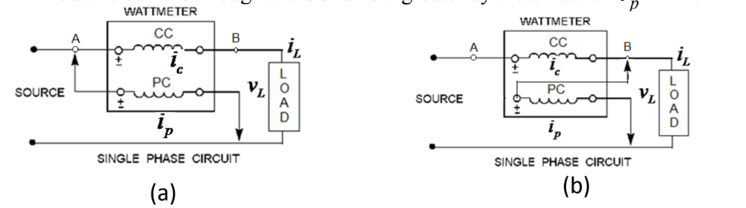
Wattmeter Connections
Practically both cannot be achieved together.
(a) With the PC connected to point ‘A’, the load current is properly metered, but the voltage across the PC is higher by the amount of the drop across the CC.
(b) With the PC connected to point ‘B’, the load voltage is properly metered, but the current through the CC is now greater by the amount .

Slide 8
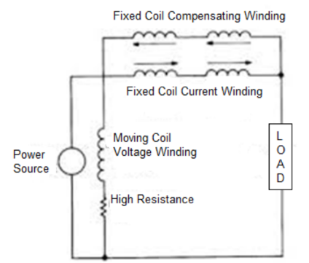
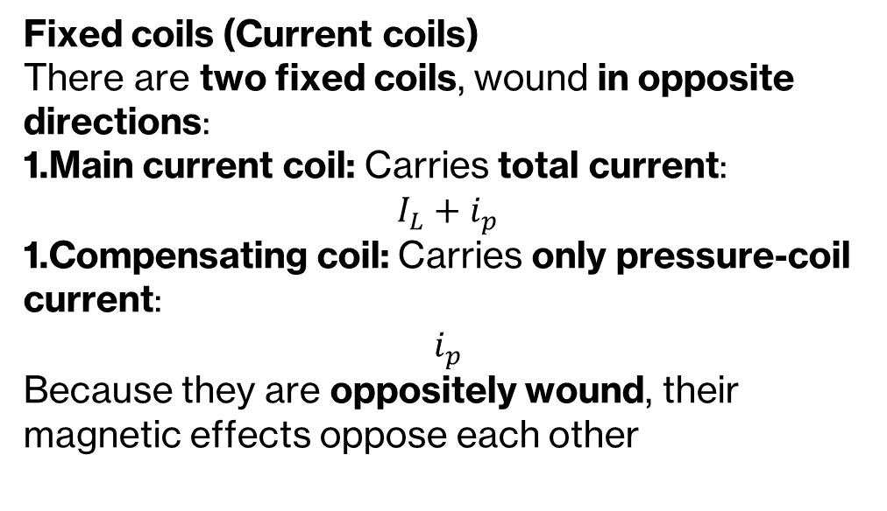
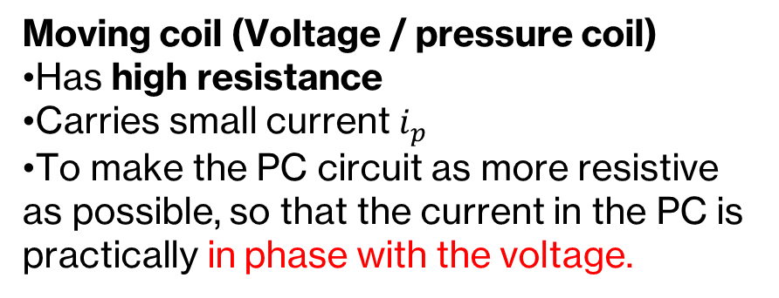
Errors Due to Wattmeter Connections
Minimizing connection error:
1. PC connects to point ‘A’ for low-current, high-voltage loads
2. PC connects to point ‘B’ for high-current, low-voltage loads
Fixed coils (Current coils)
There are two fixed coils, wound in opposite directions:
Main current coil: Carries total current:
$$I_{L}+i_{p}$$
Compensating coil: Carries only pressure-coil current:
$$i_{p}$$
Because they are oppositely wound, their magnetic effects oppose each other
Moving coil (Voltage / pressure coil)
Has high resistance
Carries small current $i_{p}$
To make the PC circuit as more resistive as possible, so that the current in the PC is practically in phase with the voltage.

Slide 9
Instrument Transformers
Called ‘Instrument Transformer’ as they are mainly used for instrumentation of the measurement of high-power system parameters, e.g. voltage, current, power, energy, power factor and frequency.
Used to step down the voltage/current to be measured. Actual measurements are done by other measuring instrument, like voltmeter, ammeter, wattmeter, energy meter.
Have wide applications in protection circuits of power systems, e.g. over-current, under-voltage, earth fault and various other kinds of relays
Types:
1. Current transformer (CT): Used to transform high current of a power line to a lower value suitable for direct connection to an AC ammeter
2. Potential Transformer (PT): used to transform high voltage of a power line to a lower value suitable for direct connection to an AC voltmeter

Slide 10
Functions of an Instrumentation Transformer
Performs two important functions:
1. Extend the range of AC measuring instrument, similar to the shunt or the multiplier resistors that extends the range of a DC meter.
CT and PT provide required range extensions through their transformation ratio.
2. Serve to isolate the measuring instrument from high-voltage power line
-It is impractical to bring the several-hundred kV high-voltage lines directly to an instrument panel because of the safety hazards involved and the insulation problems of high-voltage lines running closely together in the confined space of the instrument panel.
- CT, PT allows low-voltage, low-current wires from the transformer secondary brought to the instrument panel, thereby minimizing safety hazards and insulation problems.

Slide 11
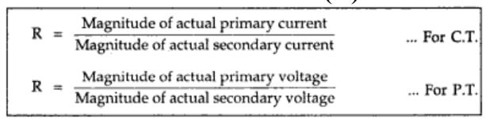
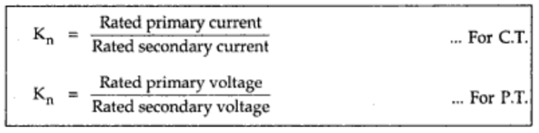
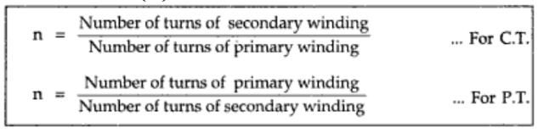
Ratios of Instrument Transformer
Actual Transformation Ratio (R):
Nominal Ratio (K_{n}):
Turn Ratio (n):

Slide 12
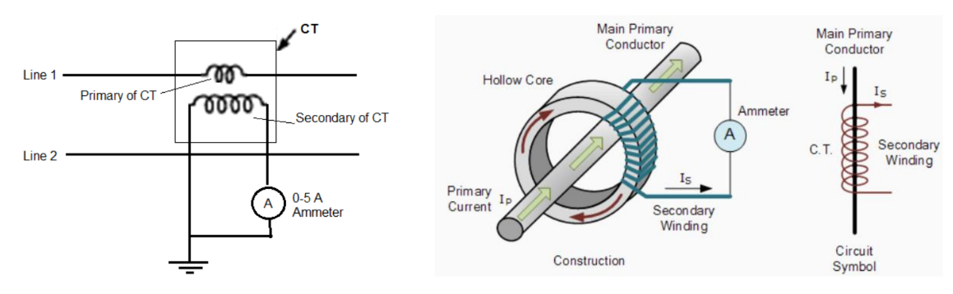
CT
Construction and special design consideration for CT:
1. Its construction is very different from the normal power transformer
2. In most cases, the primary is only one turn or a single conductor connected in series with the load/line whose current is to be measured. The secondary winding has a larger number of turns and is connected in series with the meter.
3. Often the primary winding is a single conductor in the form of a heavy bar of copper or brass running through the core of the transformer. Such a CT is called a bar-type CT.

Slide 13
CT
4. The secondary is generally designed to deliver a current of 5 A. An 800/5-A bar-type CT would have 160 turns in the secondary coil.
5. Power rating of the windings is low, as they are not meant to supply any load other than the instrument’s losses.
6. Very low voltages are involved with primary and secondary windings. So unlike PT, high insulation is not required for CT. So, its construction is very simple.

Slide 14
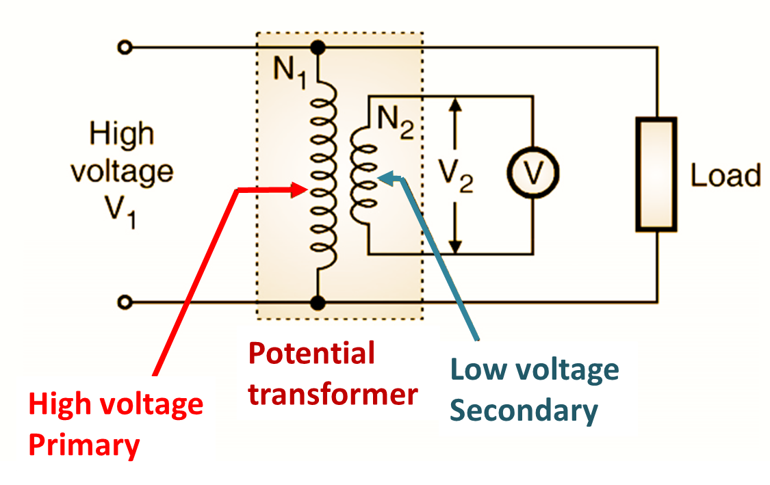
PT
Construction and special design consideration for PT:
1. Construction is similar to the normal power transformers
2. Extremely accurate ratio step-down transformer. Secondary is usually rated for 230 V irrespective of the primary voltage rating.
3. Low power winding rating, as they are not meant to supply any load other than the instrument losses.
4. For very high primary voltages, the insulation between the primary and secondary windings must be able to with-stand large potential difference.

